Slide 1
Design and Development of a Web-based Alumni Management System
Md. Al Firoz Hossain
Roll Number: CSE202103088
Registration No: 2835
Session: 2021-2022
Professor Dr. Md. Ezharul Islam
Department of Computer Science and
Engineering

Slide 2
Outline
Introduction
Background and Related Works
System Design
Implementation and Result
Conclusion and Future Work
References
2

Slide 3
Introduction
Alumni System is a online application system which can act as a interactive medium between the old student and the School, College, University or institution.
The educational institute can help in: Building and growing alumni database without much human intervention.
To stay in touch with our alumni as well as help you get to know one another through a series of programmes and activities.
3

Slide 4
Objectives
If the Alumni Association is formed, what the Association will do is mentioned below:-
Make Old students Database Archive.
It increase the awareness of communication between teachers,
students, parents.
Help students and teachers identify problems and find out solutions
It will focus University status Or specific Program like PMSCS.

Slide 5
Problem Definition
It is a very difficult task to collect the information of all the students and input on database.
Challenging is to reach out the system URL where they will full their information like job history.

Slide 6
Research Methodology
To maintain alumni association in my interest, I took an initiative to create a web system. Through which a solution to all problem can be solved.
In creating this system, I will use Python 3.10.5, Python Django 4.0.5,MySQL Database, Bootstrap for Design which is an open source and High Demandable Programing Language.

Slide 7
Outline
Introduction
Background and Related Works
System Design
Implementation and Result
Conclusion and Future Work
References

Slide 8
Background
We the alumni of JU PMSCS realize that we should have an Alumni Association like JU alumni. A website is required for this, where all organizational processes will be completed. This is as per requirement Dr. Md. Ezharul Islam Professor, Department of CSE, in order to achieve this, he realized the need for an Alumni Association. Many teachers feel that this department will be very important for it and feels that communication between teachers and former students will increase.

Slide 9
Related Works
Alumni Association is an organization of alumni of an institution which creates a common platform with the alumni, strengthens brotherhood and unity, fulfills the responsibility towards the school, college, university from the sense of responsibility as an alumni and organizes necessary social and cultural events.
Now we will look at several sites that alumni have created for their institutions. And we will try to find out some of their public feature. That will help to create a clear comparison. And admin panel will be hide on our internal policy.

Slide 10
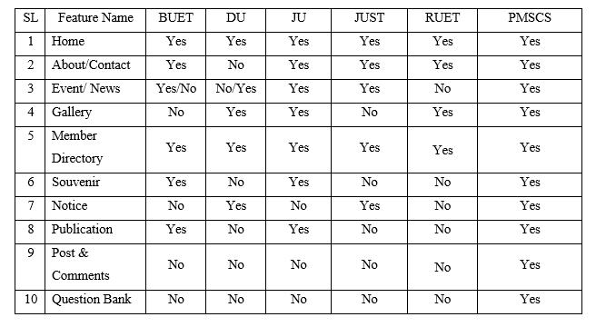
Gap Comparison Table

Slide 11
Outline
Introduction
Background and Related Works
System Design
Implementation and Result
Conclusion and Future Work
References

Slide 12
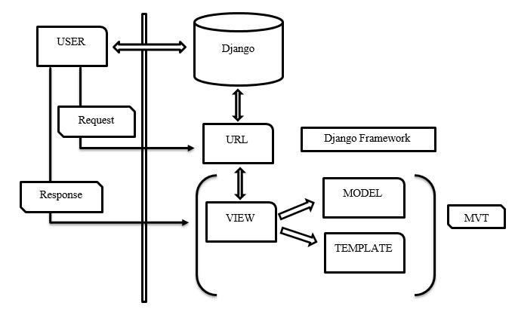
Framework Environment
A High-level Python[3.10.5] web framework is the most powerful and demandable web framework for web development. Model View Presenter (MVP) is the development process for Python Django.

Slide 13
Tools and Technologies
Particular | Supportive Software
Platform | Windows
Language | Python
Framework | Django
Design | Bootstrap
Framework | JavaScript
Database | MySQL
Webserver | Xampp

Slide 14
System Design Model List
Model are directly related to database with admin access. To develop this site I have created some model according to functional requirement. Model list are following:-
Index Model | Student_info Model | Gallery Model | Others Model
Basic_setup Slider About_alumni Message Message_box News_event Campus_beauty Program_basic Program_history Mission_vision_history Contact_info | Batch_list Job_category Job_designation Expertise_language Student_profile | Gallery_image Souvenir_setup Souvenir | Publication Notice Wall_post Wall_post_comment

Slide 15
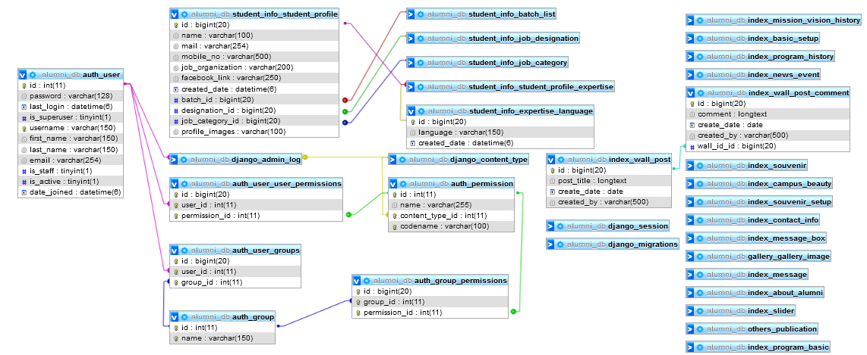
ERD Diagram for Alumni Management System

Slide 16
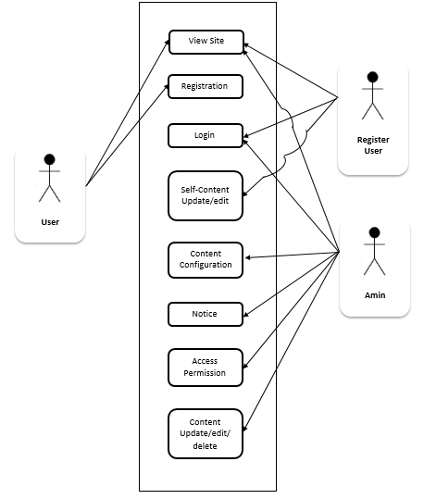
Use Case Diagram

Slide 17
Outline
Introduction
Background and Related Works
System Design
Implementation and Result
Conclusion and Future Work
References

Slide 18
Hardware Requirement for Python Django
Required Memory: 4 GB.
Required Graphics Card: AMD Radeon R5 M230.
Required CPU: Intel Core i3-2340UE.
Required File Size: 3 GB.
Required OS: Windows 7/8/10/11

Slide 19
Sample Code For Setting
BASE_DIR = Path(__file__).resolve().parent.parent SECRET_KEY = 'django-insecure-gogvv%pnyyzqi@^cn6pxmsh*6h7lig#^dgs=&#deqkqw+(oa(e' DEBUG = True ALLOWED_HOSTS = [] INSTALLED_APPS = [ 'django.contrib.admin', 'django.contrib.auth', 'django.contrib.contenttypes', 'django.contrib.sessions', 'django.contrib.messages', 'django.contrib.staticfiles', 'index', 'news_event', 'student_info', 'gallery', 'others',]
ROOT_URLCONF = 'AlumniManagement.urls'

Slide 20
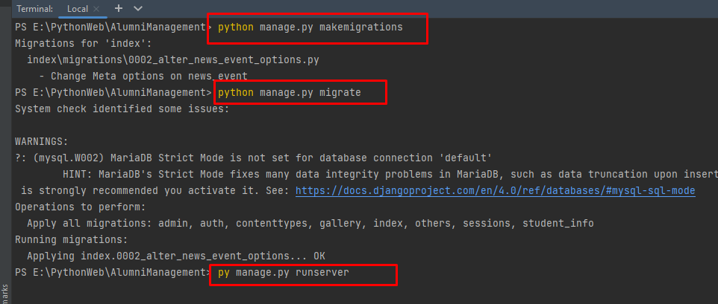
Project Run Script
After complete the project it have some command to run on server that is the most important in every project. My project run command have 3 step that are bellow
py manage.py makemigrations
py manage.py migration
py mange.py runserver

Slide 21
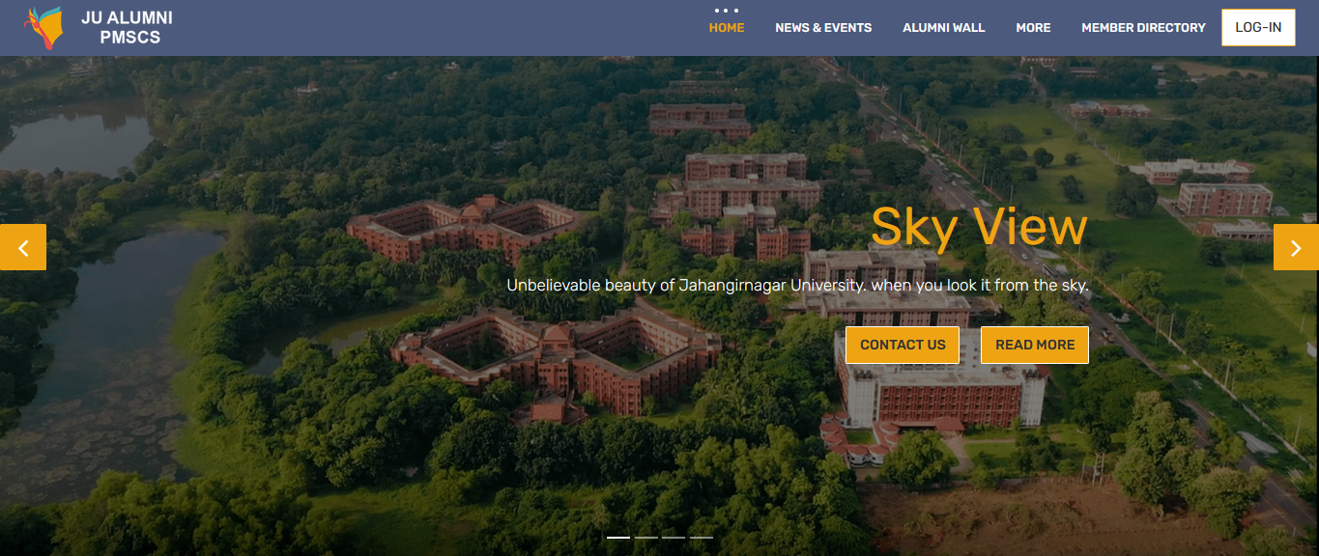
Home page
Successfully run the project system will provide a URL for access the developed project. In such way we also get an URL that in local host access. And final the home page of our PMSCS Alumni web system are as follow.

Slide 22
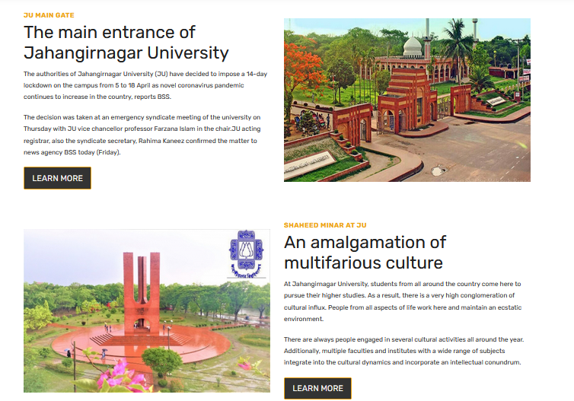
Home page
For site beautification or any important view of association, admin can show that in home page with proper image and content with title. This also are configurable on admin panel.

Slide 23
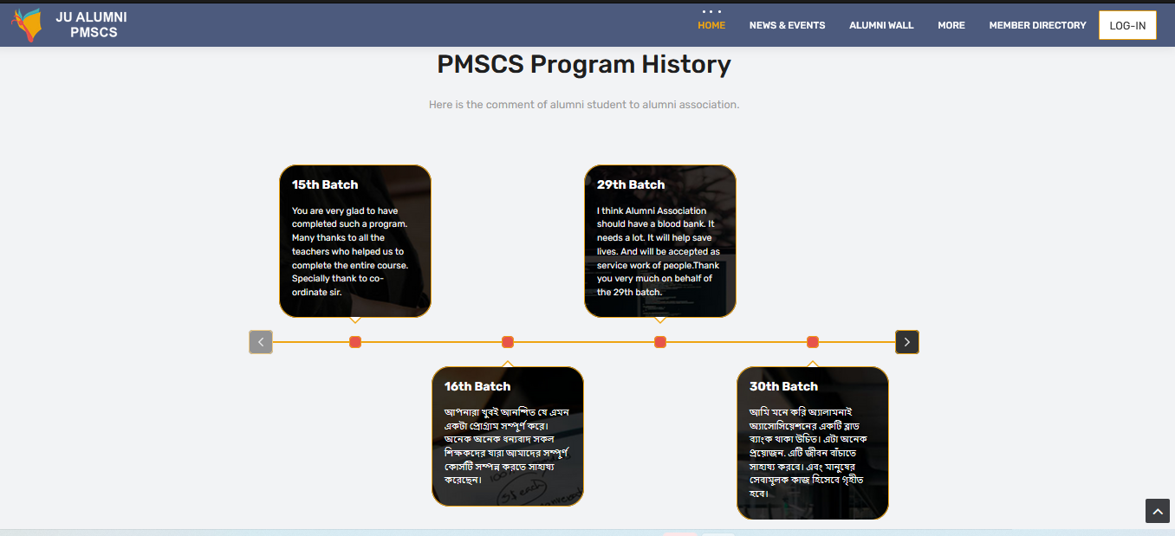
Home page
Our system can store batch wise program history and this are also configurable on admin panel. Admin user only can insert, delete or update this information.

Slide 24
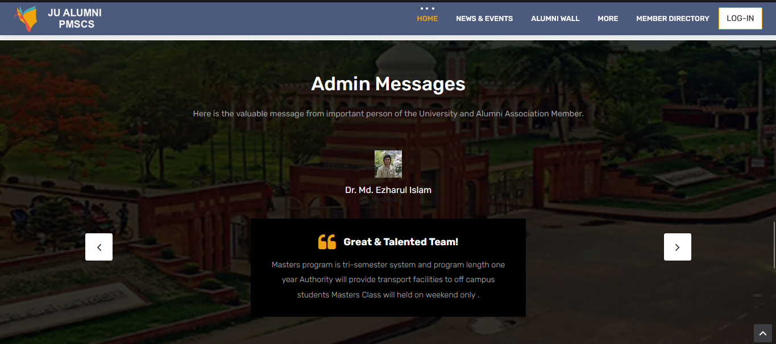
Home page
Admin or teacher can through message to user or alumni student. This is the UI view for home page just 2 step footer up place.

Slide 25
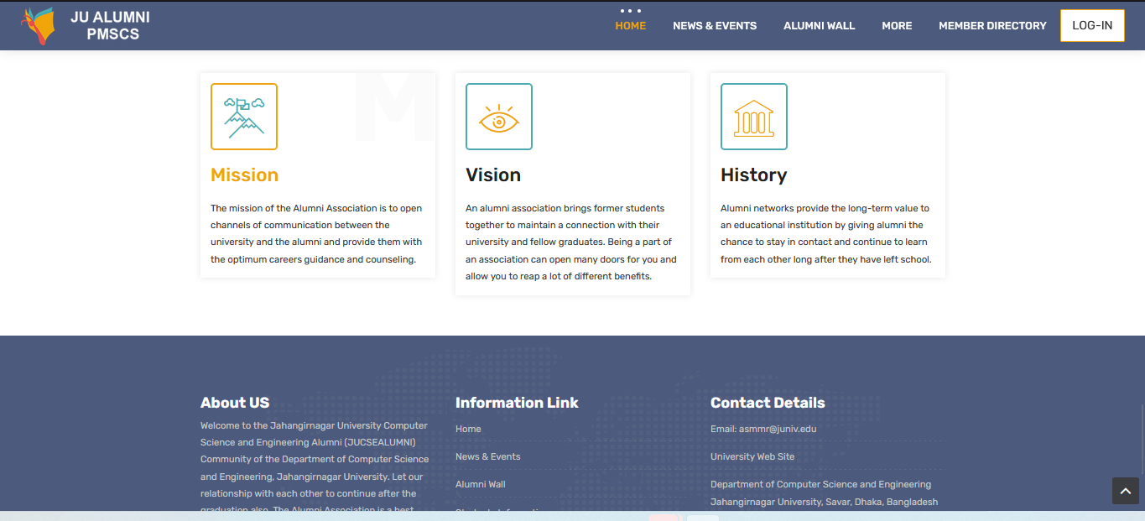
Home page
This is the view of mission, vision and history of alumni management system that is configured in admin panel. All are editable on admin access option.

Slide 26
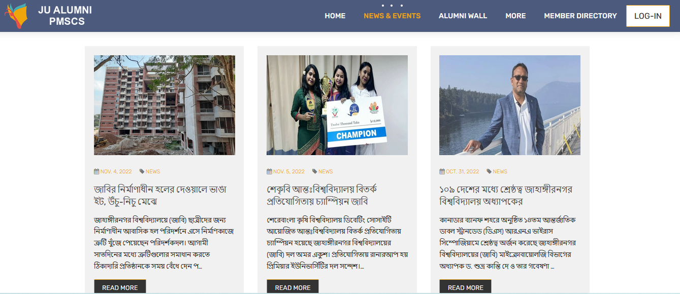
News & Events Page
This system a menu option named News and Event that is actually will be used for alumni association and event program related news as like a newspaper.

Slide 27
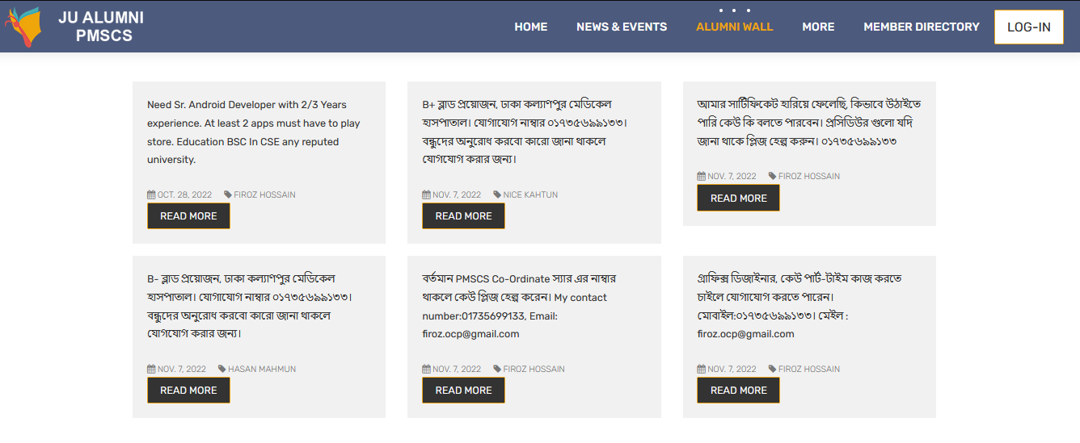
Alumni Wall Page
The Most attractive menu of this system is Alumni wall. This actually like a Facebook news feed to friends. Register user can post a status and others can comments.

Slide 28
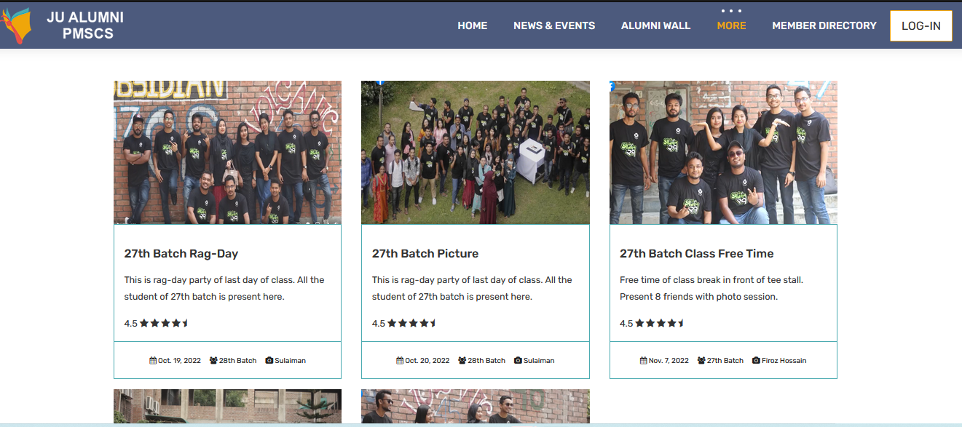
Souvenir Page
This system can take and display souvenir information with picture. Admin can insert update and delete this on his admin panel.

Slide 29
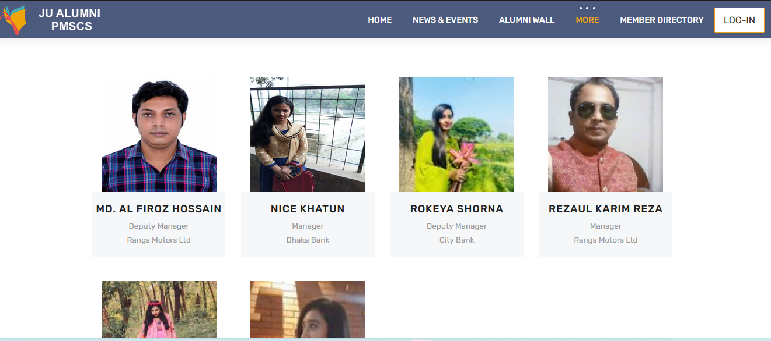
Student Information Page
This is the view of register user list. Any user can view basic information from here. This is public view have no restriction but hare is available few of information not details of all in database.

Slide 30
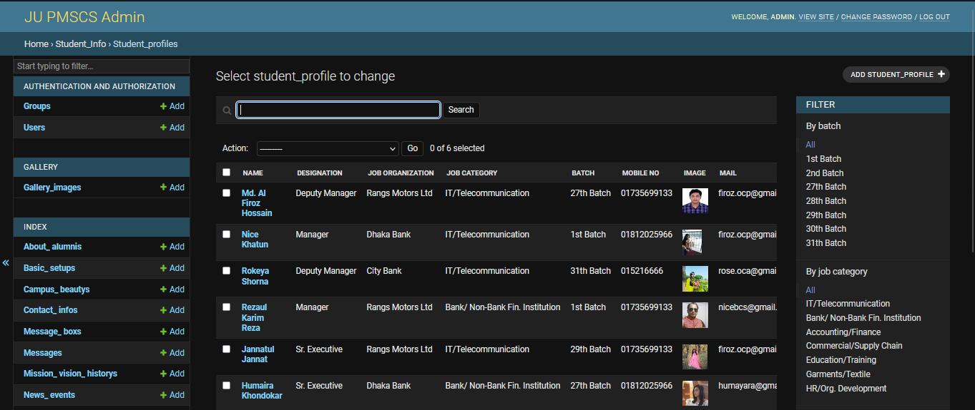
Student List on Admin Panel
Admin panel of register user, have only access of admin authenticated user. Hare have a great searching mechanism for searching specific category wise information.

Slide 31
Testing
Step one: we will select test factors and rank them. Selected test subjects such as reliability, maintainability, portability or etc., will be placed according to their rank in the matrix.
Step two: Identifying the stages of the development process. The phase should be recorded in the matrix.
Step three: Software deliverables identify business masks. Risks will be ranked into three ranks as high, medium and low

Slide 32
Outline
Introduction
Background and Related Works
System Design
Implementation and Result
Conclusion and Future Work
References

Slide 33
Conclusion
The concept of alumni management system can be present in many way for this consideration this are make for dynamic representation. Any institute can use this system with configuring admin panel. Each and everything are possible to configure inside admin panel.
This are develop by using python programing language that are most valuable and high securable among others language. Every student can communicate with alumni student that helps them for professional life. Current student can take demandable consultancy from them and also can take previous question for their campus study.

Slide 34
Future Work
As this system is developed by Python Django model base framework so there have easy option to include any model or update. I have added most important feature on this project. Anyone can add any others feature without considering others model

Slide 35
References
[1] BUET Alumni website. Accessed: Nov. 3, 2022. [Online]. Available: http://buetalumni.org
[2] Dhaka University Alumni website. Accessed: Nov. 4, 2022. [Online]. Available:
https://duaa-bd.org
[3] Jahangirnagar University Alumni website. Accessed: Nov. 5, 2022. [Online]. Available:
https://jucsealumni.org/home
[4] IUBAT—International University of Business Agriculture and Technology alumni web site.
Accessed: Nov. 5, 2022. [Online]. Available: https://iubat.edu/iubat-alumni-association
[5] Daffodil International University. Accessed: Nov. 5, 2022. [Online]. Available:
https://daffodilvarsity.edu.bd/alumni-list
[6] The Django Book, a free book about the Django Web framework for the Python programming
Language. Available: https://django-book.readthedocs.io/en/latest/
[7] Django Web Framework. [Online]. Available: https://learnbatta.com/course/django
[8] Ian Somerville, “project planning”, Software Engineering Pearson Education, Update 8th
Edition, 1989-1992.

Slide 36
Thank you.

